Slide 1
BankBytes
Final report

Slide 2



BANKBYTES
Mark Kimutai Kitur
kiturmark@gmail.com
Kenya
Dedan Kimathi university
Of technology
Data Science
Yue hu
hy1550278246@gmail.com
The United Kingdom
Durham University
Data Science
Rakshith Nagaraju
rakshith.nagaraj6@gmail.com
The United Kingdom
University of Liverpool
Data Science

Slide 3
Preparation of data for model building
For a model to clearly learn the data and make good prediction on unseen data, columns which have less correlation should be removed. In this case we removed columns: nremployed, empvarate and conspriceidx. (The correlation is shown in the next page).

Slide 4
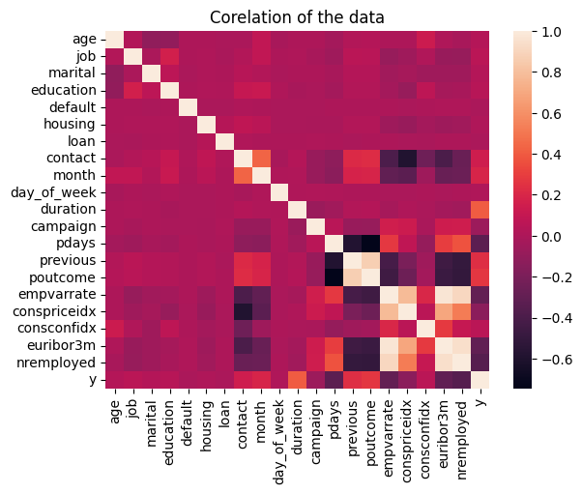
A graph showing relation among the columns

Slide 5
Evaluation Metrics
Evaluation Metrics are criteria used to assess the performance of Machine Learning models.
These metrics provide quantitative measures that help in understanding how well a model performs.
These measures are used to measure and guide the selection process and tuning of the models which are eventually deployed in real world applications.

Slide 6
Metrics Used
Accuracy
Precision
Recall
F1-Score
AUC-ROC

Slide 7

Accuracy
Accuracy is used to gauge the overall correctness of a model, especially when the dataset has balanced classes.
Measures the proportion of correctly classified instances out of the total instances.
Helps in quickly understanding how often the model is making correct predictions.

Slide 8

Precision
Precision focuses on the quality of positive predictions.
Proportion of true positive predictions among all positive predictions.

Slide 9

Recall
Recall focuses on the coverage of actual positive instances.
Proportion of true positive predictions among all actual positives.

Slide 10
Purpose of Precision vs Recall
These metrics help in understanding the types of errors a model is making, which is crucial in applications where the cost of false positives and false negatives differ significantly (e.g., medical diagnosis, fraud detection).
Precision is prefered in Medical diagnosis as having to check for something that may not be true is better than ignoring it thinking it was negative.
Recall is preferred in Fraud detection because you can check for fraud in something that is not actually a fraud but the other way around is harmful.

Slide 11
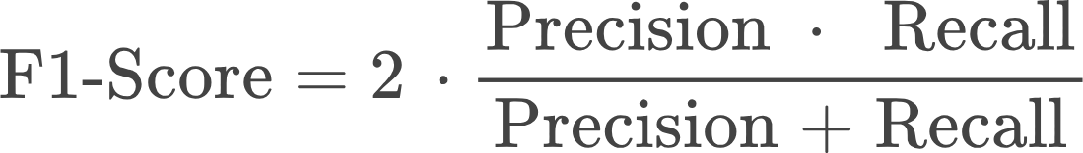
F1-Score
F1-Score combines precision and recall into a single metric.
Similar to F1 Score but gives more weight to Recall.
Provides a balanced measure of a model’s performance, particularly useful for imbalanced datasets where a single metric like accuracy can be misleading.

Slide 12
AUC-ROC
AUC-ROC is used to evaluate the performance of a binary classification model.
Usually used in Financial models.
ROC Curve: Plots True Positive Rate (Recall) against False Positive Rate.
AUC: Represents the probability that a randomly chosen positive instance is ranked higher than a randomly chosen negative instance.
Allows for easy comparison of multiple models’ performance in terms of their discriminatory power.

Slide 13
By using these evaluation metrics, we can:
Ensure that the models meet the required criteria for performance.
Adjust the hyperparameters that can fine tune the performance to address specific business needs.
Make informed decisions on which models to use during deployment.

